Slide 1
mik.pieniazek@dmu.ac.uk
www.proficio-faber.org
resources available on this webpage COSMETICS

Slide 2
proficio-faber

Slide 3
Lecture 1 - Sustainable cosmetics enterprise + innovation
- cosmetics new product development (NPD)
Lecture 2 - Sustainable Cosmetics NPD case studies - integrating 10 generic innovation triggers for sustainable NPD into 6 cosmetics enterprise + innovation scenarios
Lecture 3 - Cosmetics Products NPD Project Process - the mechanics of project phases, methodologies, management strategies, process roles and collaboration
COSMETICS ENTERPRISE + INNOVATION- 3 lectures

Slide 4
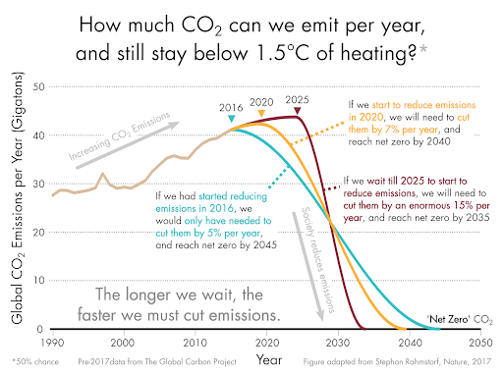
re-generative sustainability
circular economy
80% driven
by ‘design’ choices

Slide 5
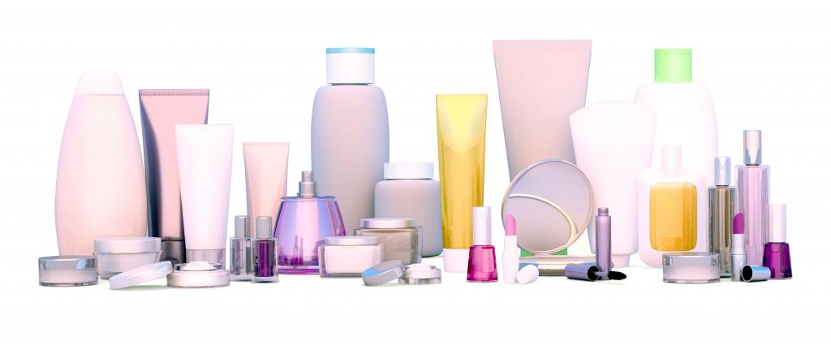
PRODUCT INNOVATION PRIMER - COSMETICS

Slide 6
Anthropological Exemplar
Universal Innovation Scenario
Cosmetics Innovation Practice
Circular Economy Product Innovation

Slide 7
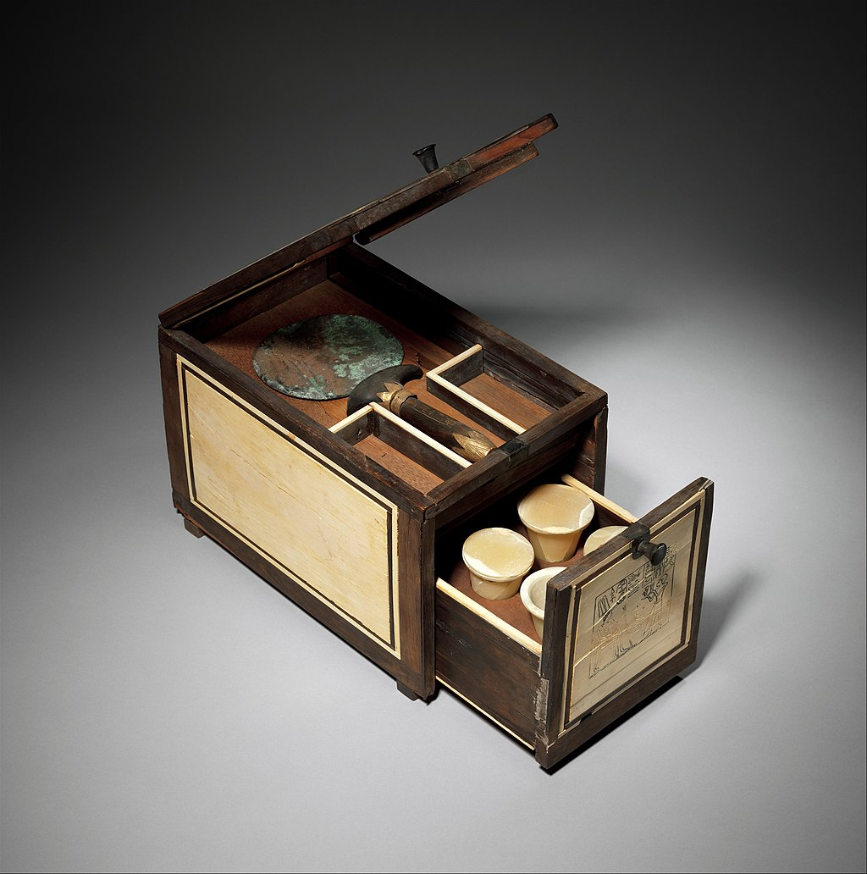
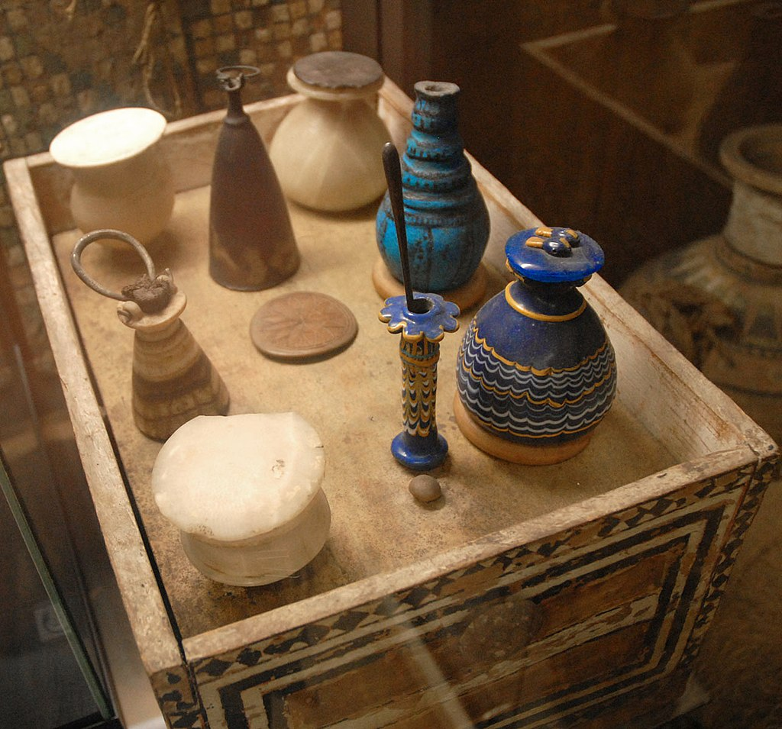
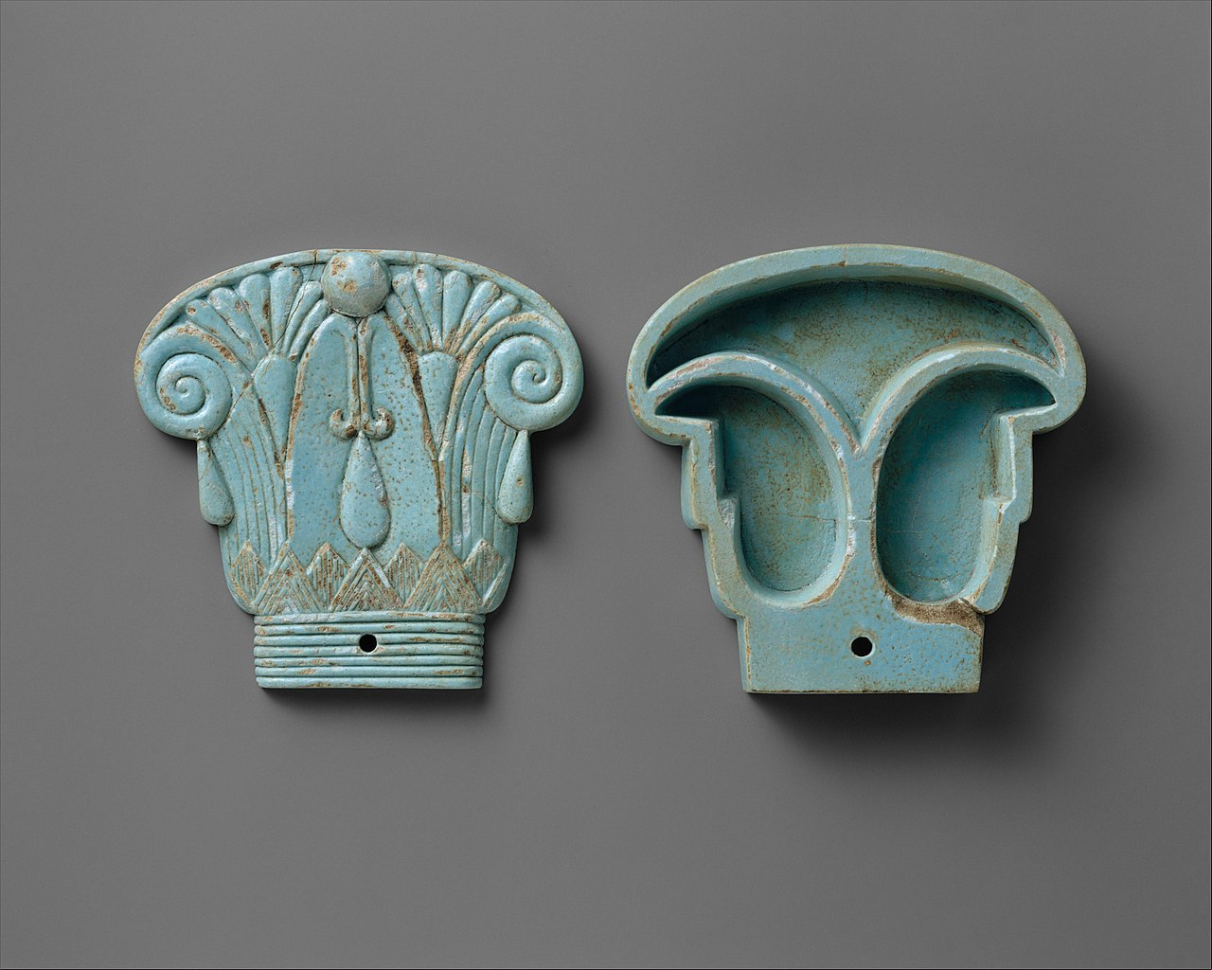
Cosmetic Box of the Royal Butler Kemeni;
1814–1805 BC
Merit's cosmetic box
circa 1390-1352 BC
Cosmetic box in the shape of an Egyptian composite capital
664–300 BC
Anthropological Exemplar

Slide 8
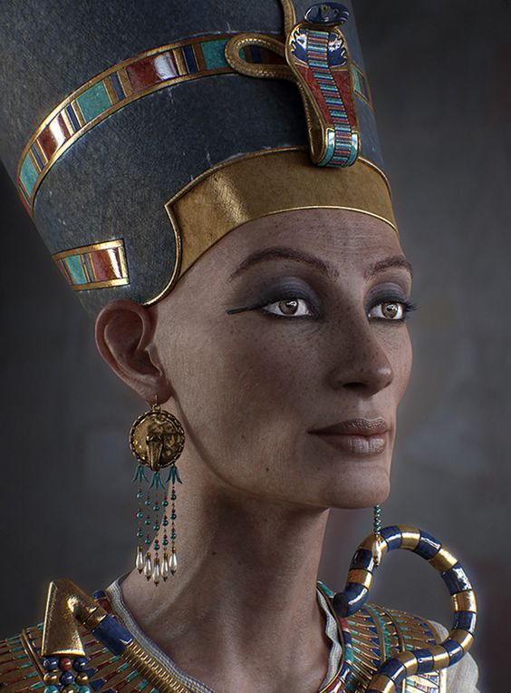
Neferneferuaten Nefertiti
born 1370 BC
( ‘the beauty has come’)

Slide 9
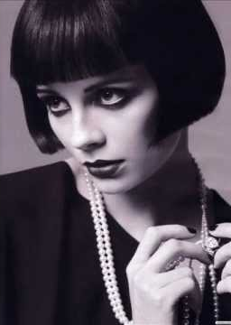
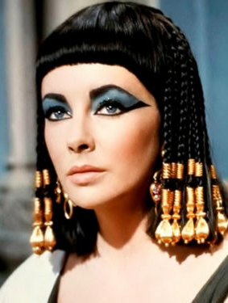
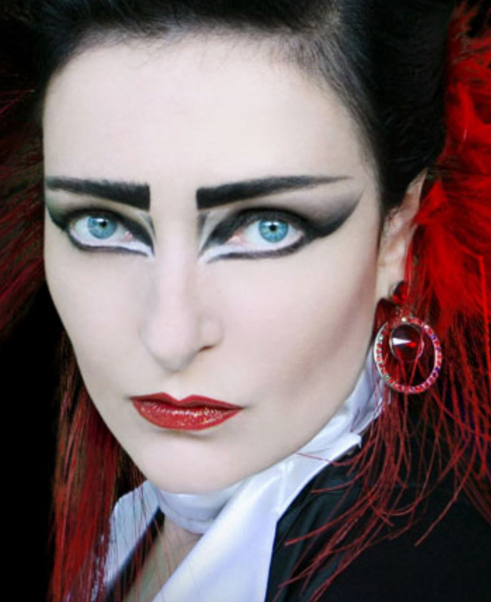
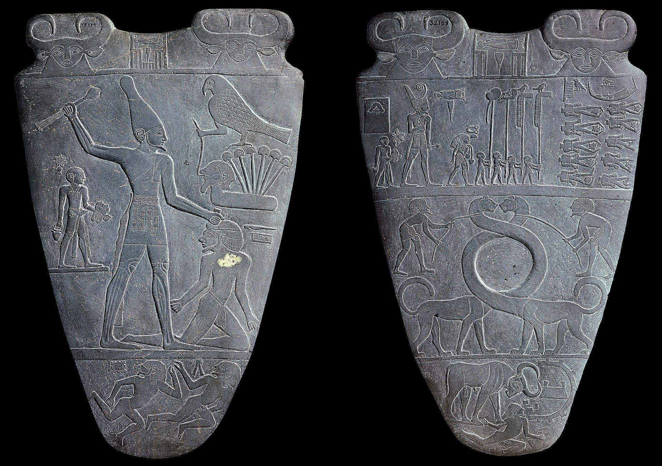
Cosmetologist
Cosmetic Box of the Royal Butler Kemeni;
1814–1805 BC
Louise
Brookes
1930’s
Elizabeth Taylor
1960’s
Siouxsie Sioux
1980’s
The two main forms of eye makeup were grepond eye paint and black kohl. The green eye paint was made of malachite, a copper carbonate pigment, and the black kohl was made from galena, a dark grey ore. Crushed charcoal was also used in this process.
Mesdemet or kohl was used for lining the eyes and were revealed to bring along potent health benefits in the form of protection from disease, bugs and sun rays
https://edition.cnn.com/style/article/ancient-egypt-beauty-ritual-artsy/index.html
The use of cosmetics in ancient Egypt varied slightly between social classes, where more make-up was worn by higher class individuals as wealthier individuals could afford more cosmetics.
Neferneferuaten Nefertiti
Born 1370 BC
( the beauty has come’)
Although there was no prominent difference between the make-up styles of the upper and lower class, noble women were known to pale their skin using creams and powders. Dark skin was associated with the lower class, who tanned while laboring in the sun, whereas pale skin was associated with the nobility.
Narmer - mixing palette
3200–3000 BC (circa)

Slide 10
Enterprise
Strategy
Market
Context
Performance
Technology
Product
Experience
Production
Technology
Lifestyle
Culture

Slide 11
Universal Innovation Scenario

Slide 13
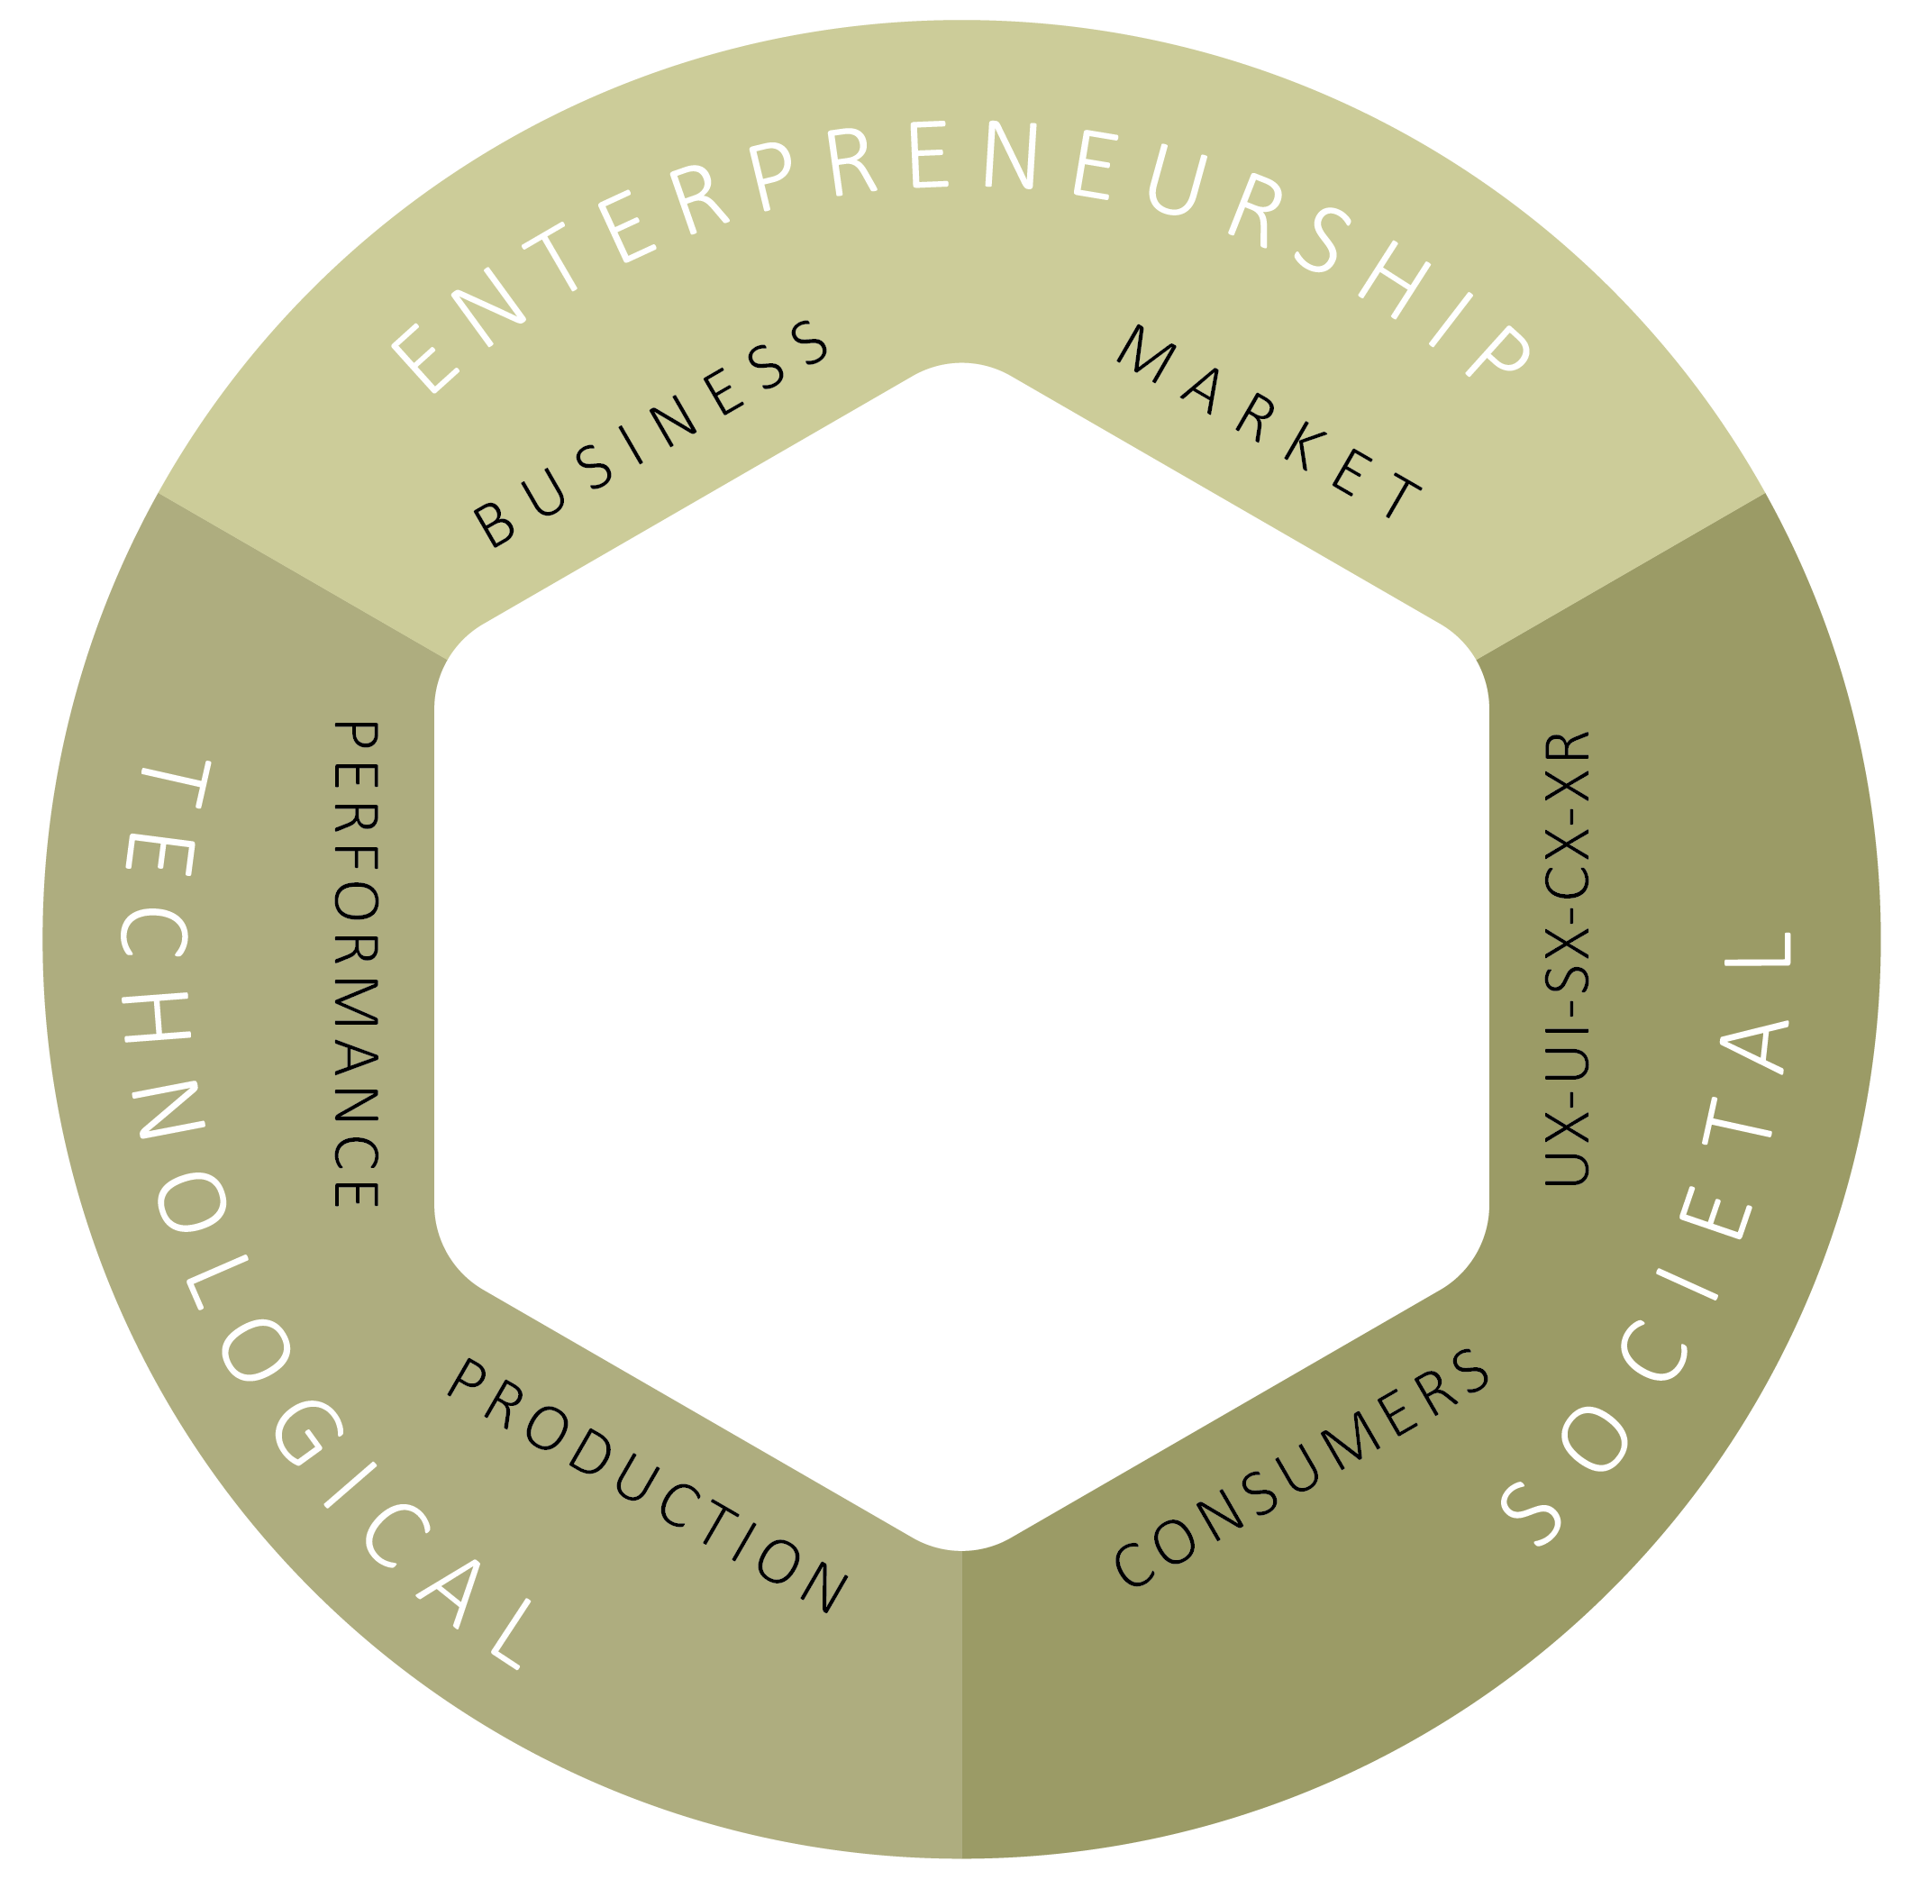

Slide 14
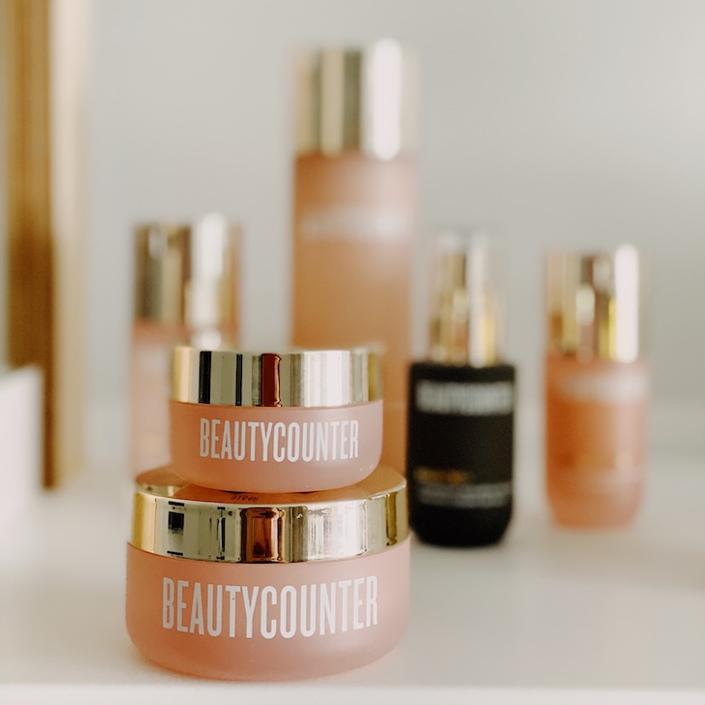

Slide 15
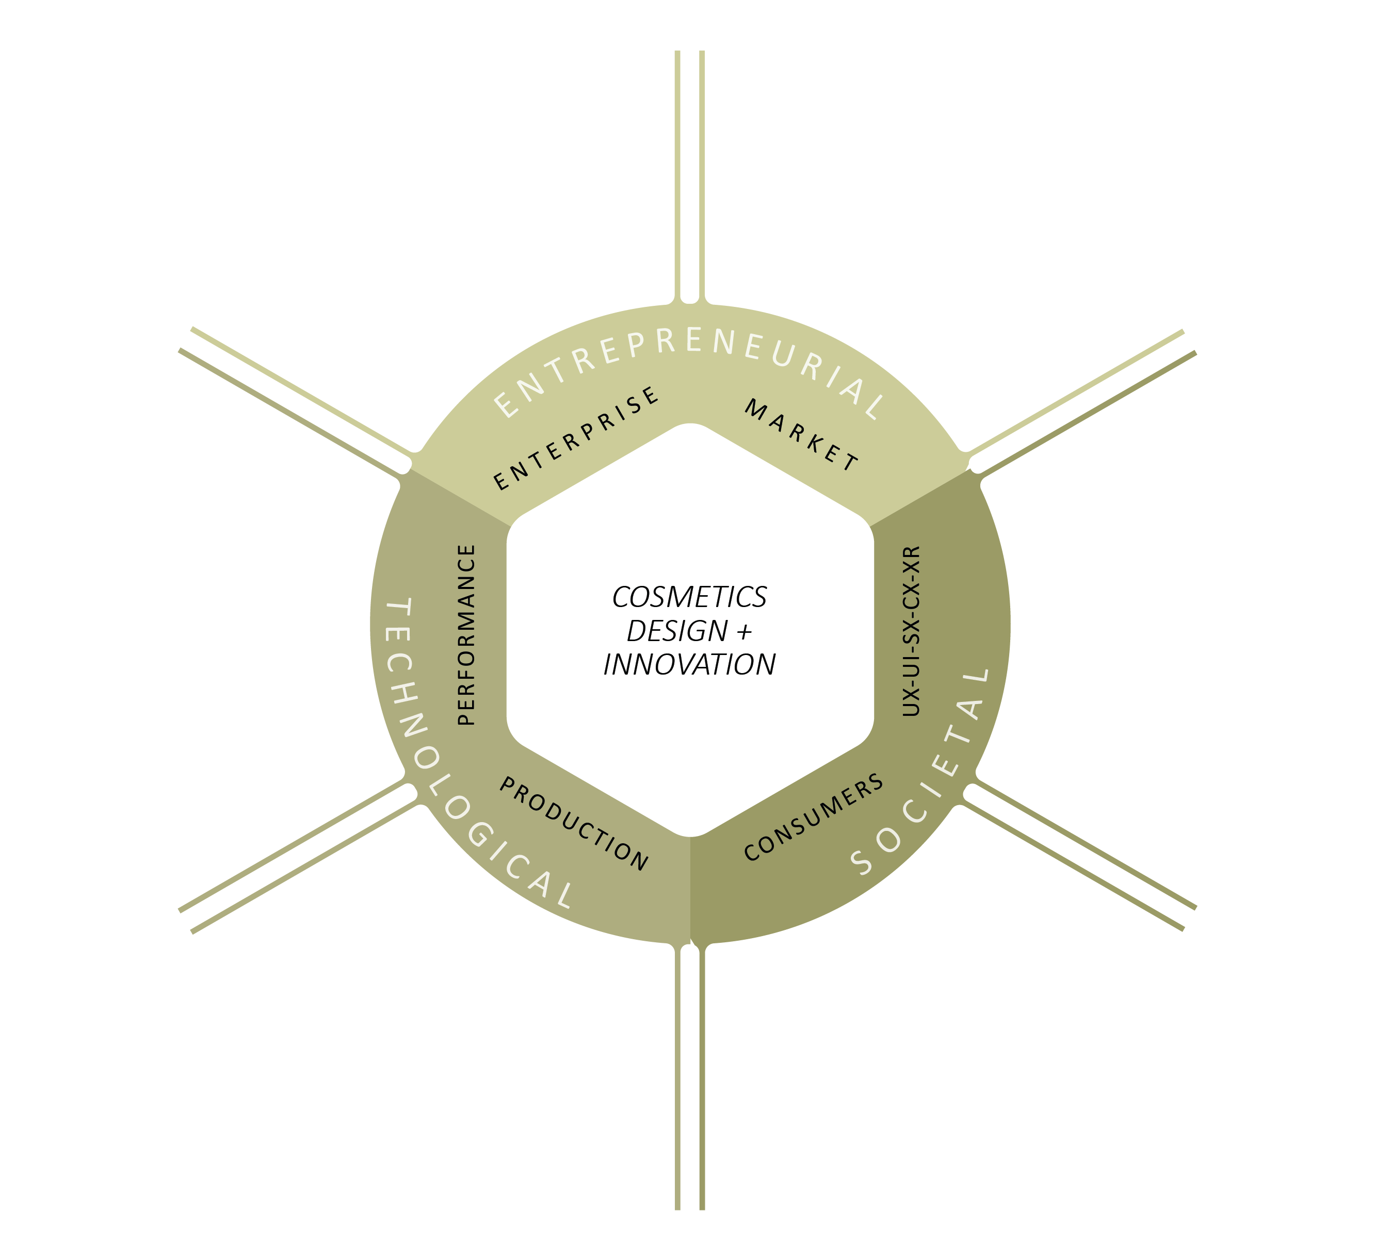

Slide 16
ROI - scale
innovation roadmap
Product inventory
brand
niche / sector
differential
ingredients
formats
variability
purpose
process
outcome
scale
adaptability
costs
values
motivations
behaviours

Slide 17
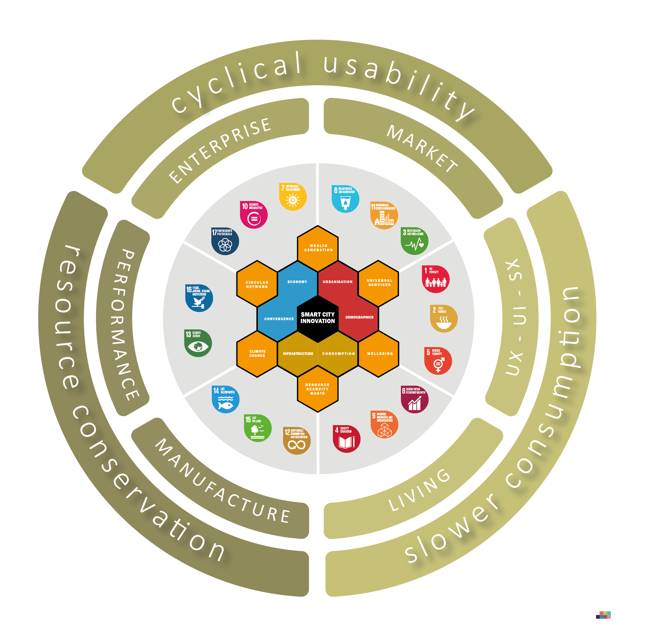

Slide 19
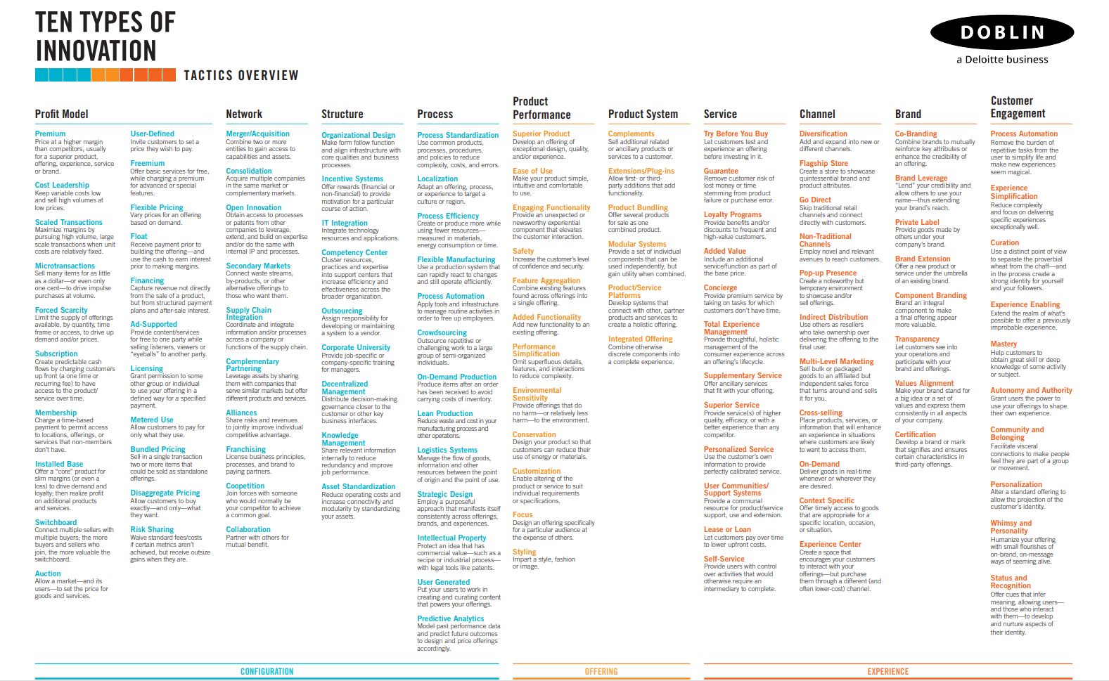
Preparing a resource for cosmetics
6 cosmetics enterprise + innovation scenarios models
explored as case studies – next week ( 2 of 3)

Slide 20
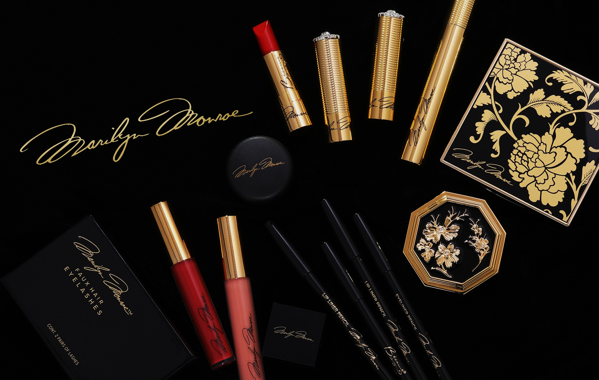
Cosmetics Innovation Practice

Slide 21
ROI - scale
innovation roadmap
Product inventory
brand
niche / sector
differential
ingredients
formats
variability
purpose
process
outcome
scale
adaptability
costs
values
motivations
behaviours
Design -Think - Storm

Slide 22
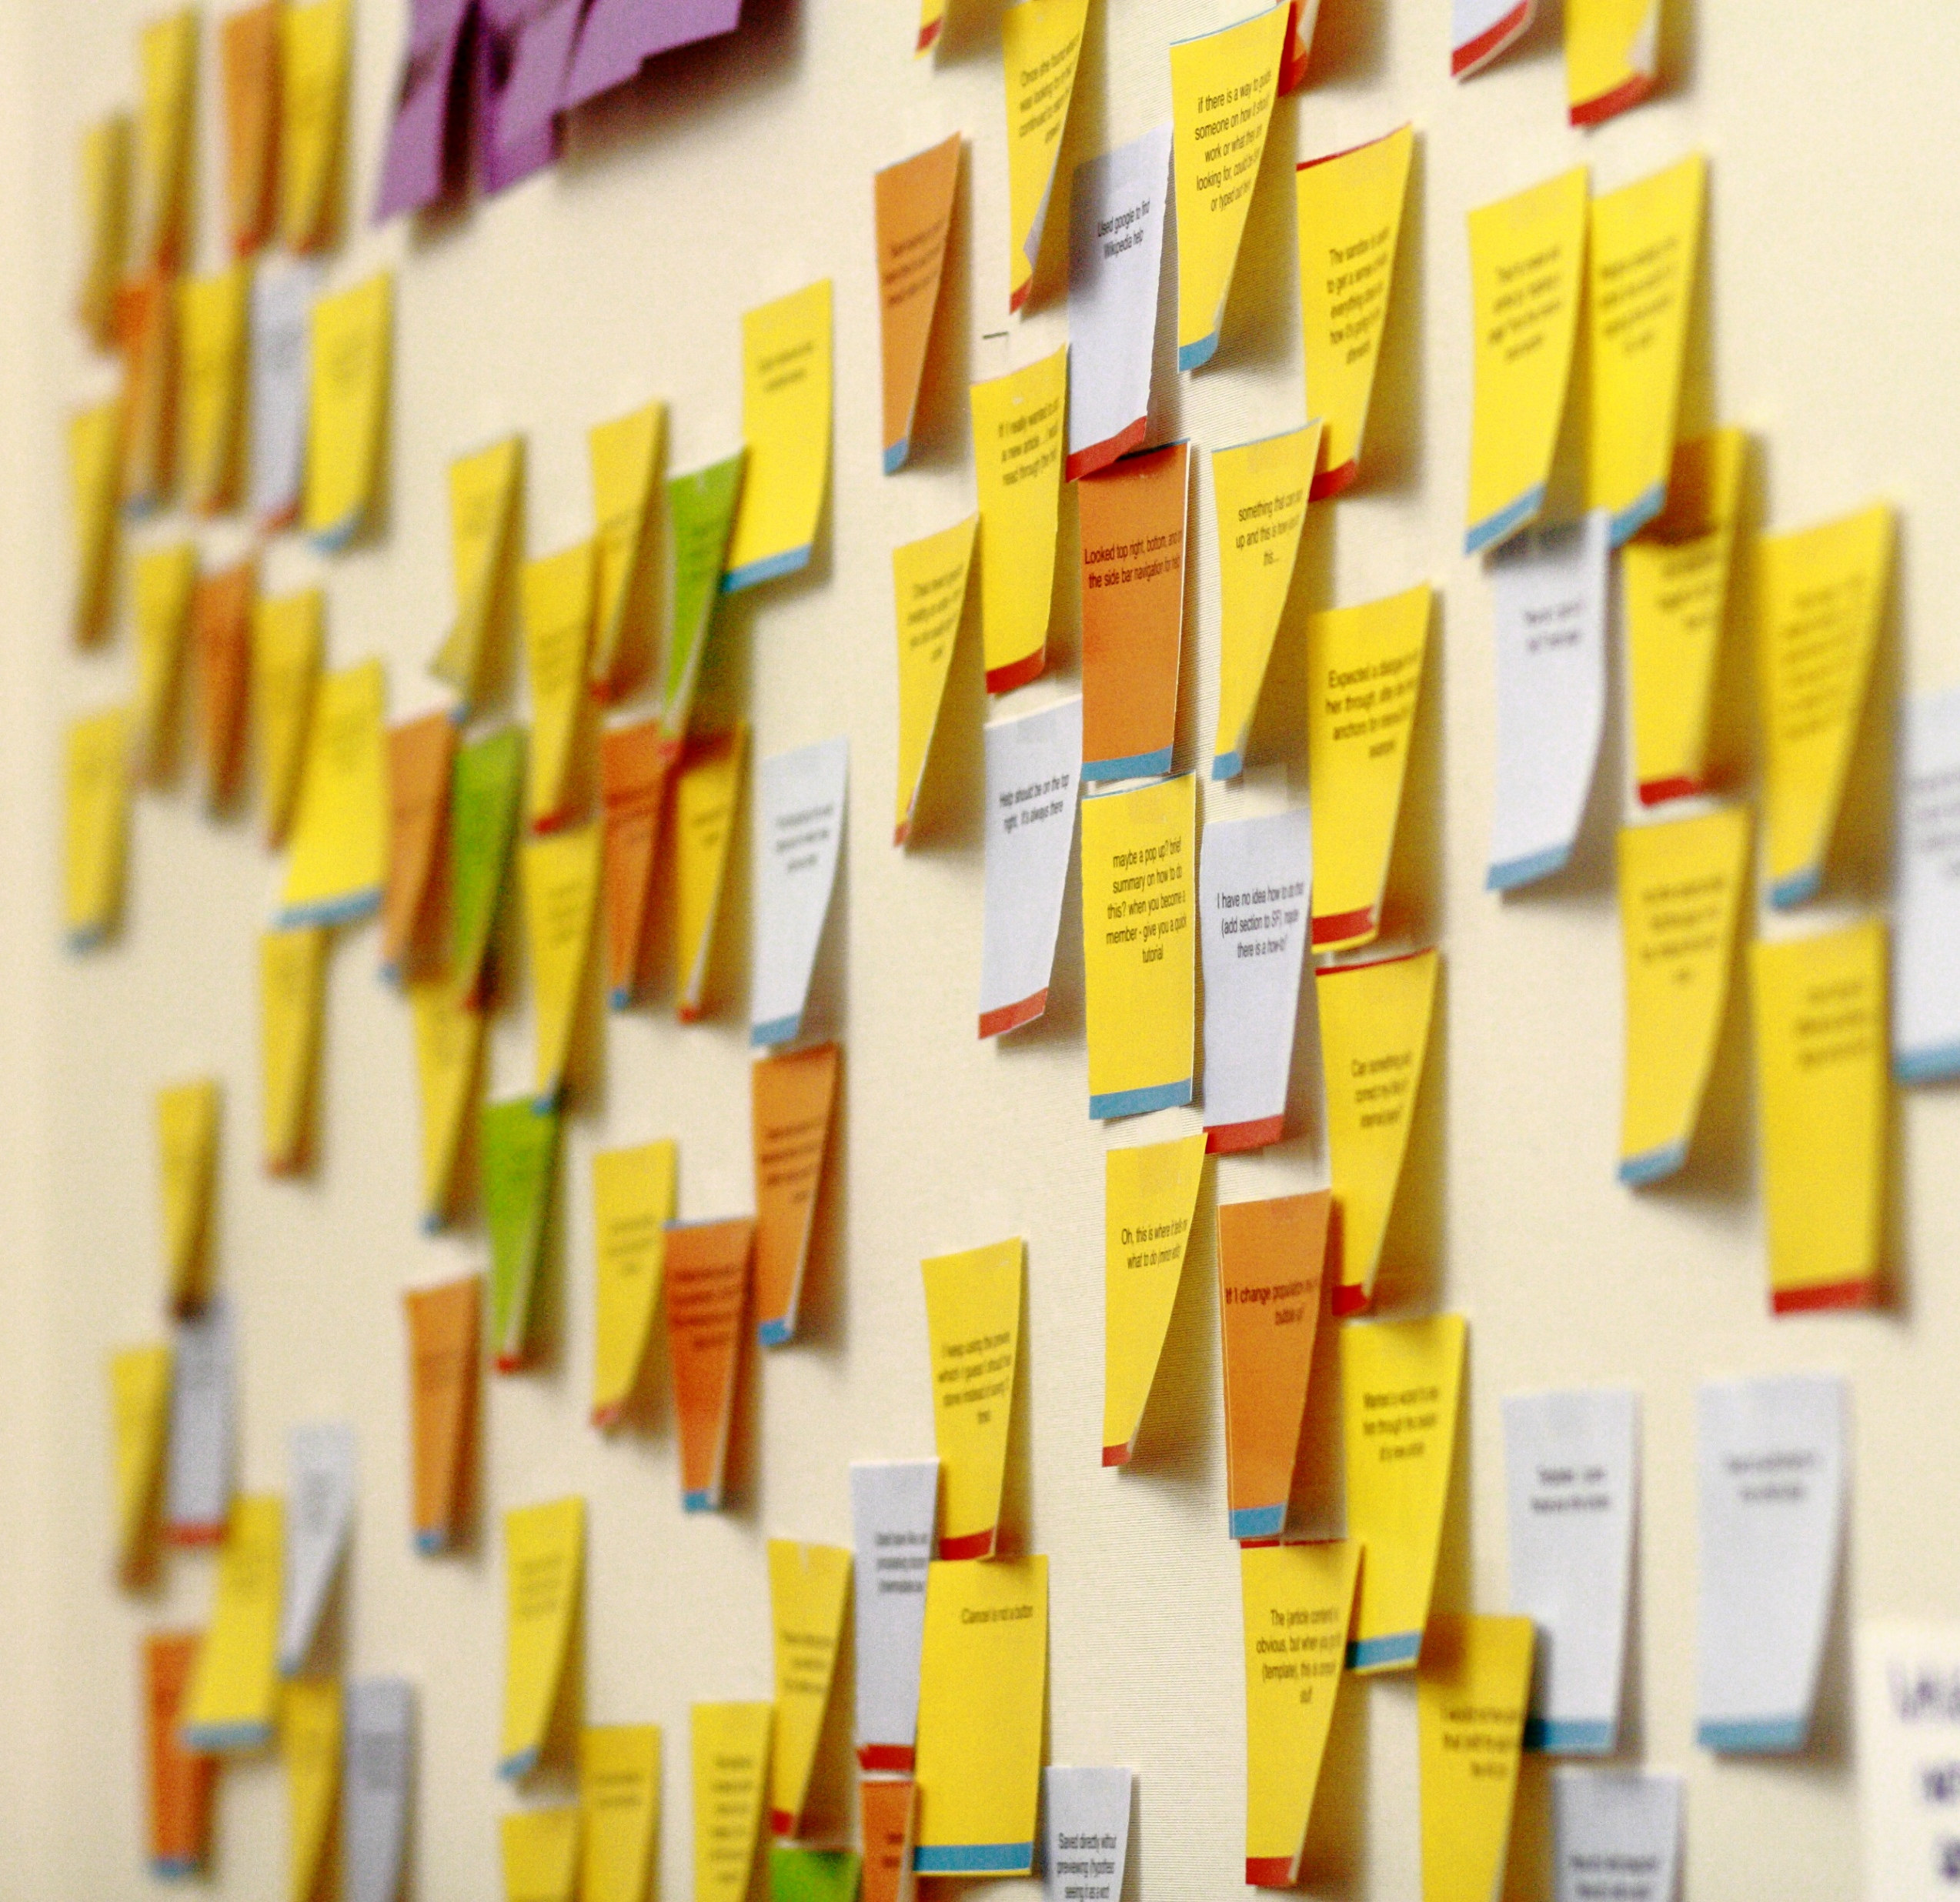
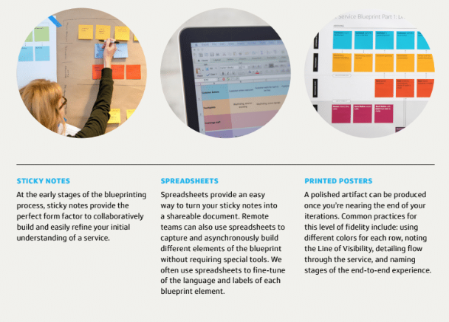
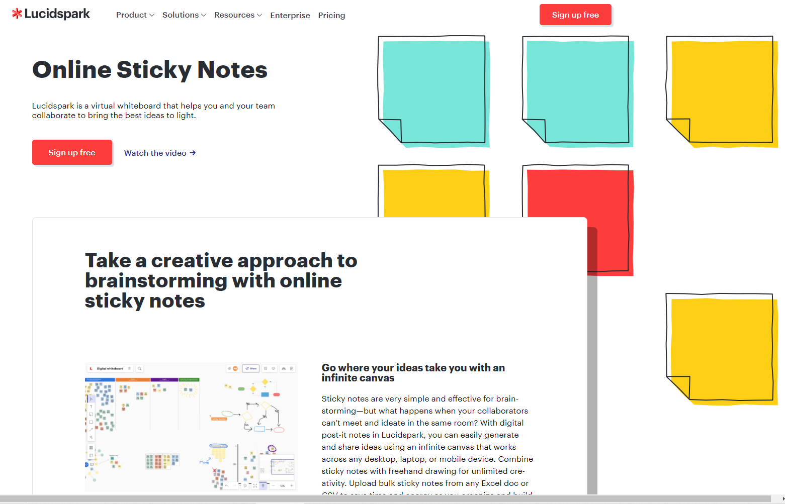

Slide 23
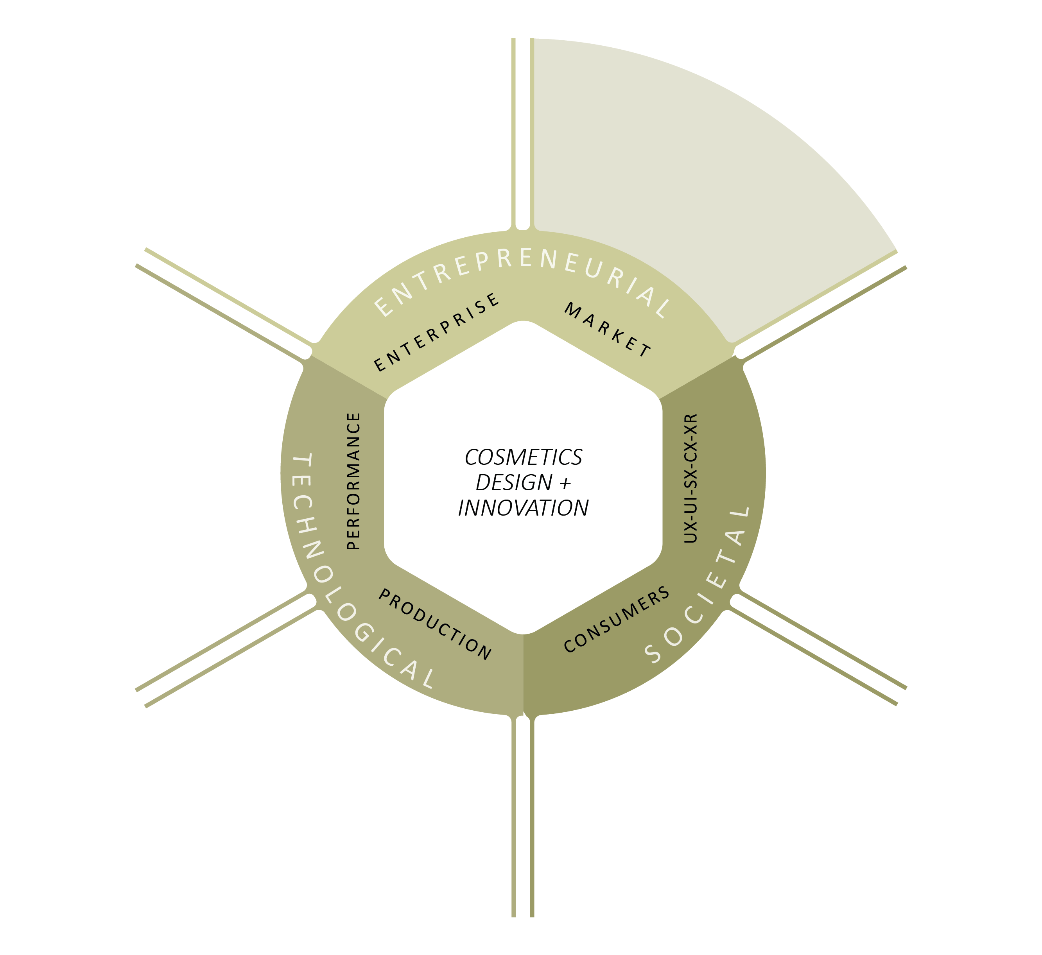
ROI - scale
innovation roadmap
Product inventory
brand
niche / sector
differential
ingredients
formats
variability
purpose
process
outcome
scale
adaptability
costs
values
motivations
behaviours

Slide 24
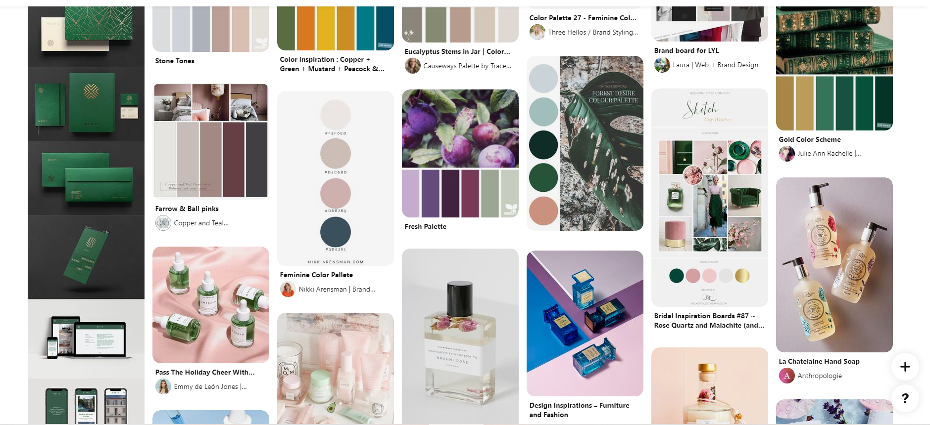
Cosmetic Brand and Packaging Design - 900+ versions

Slide 25
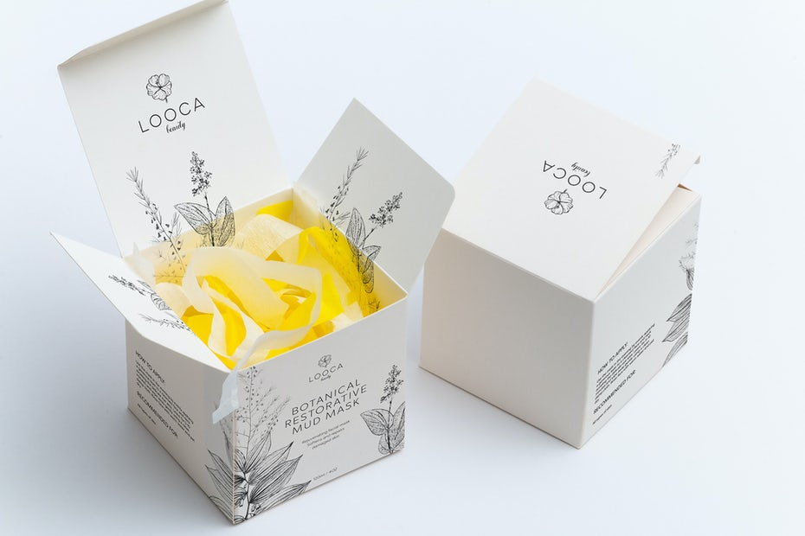
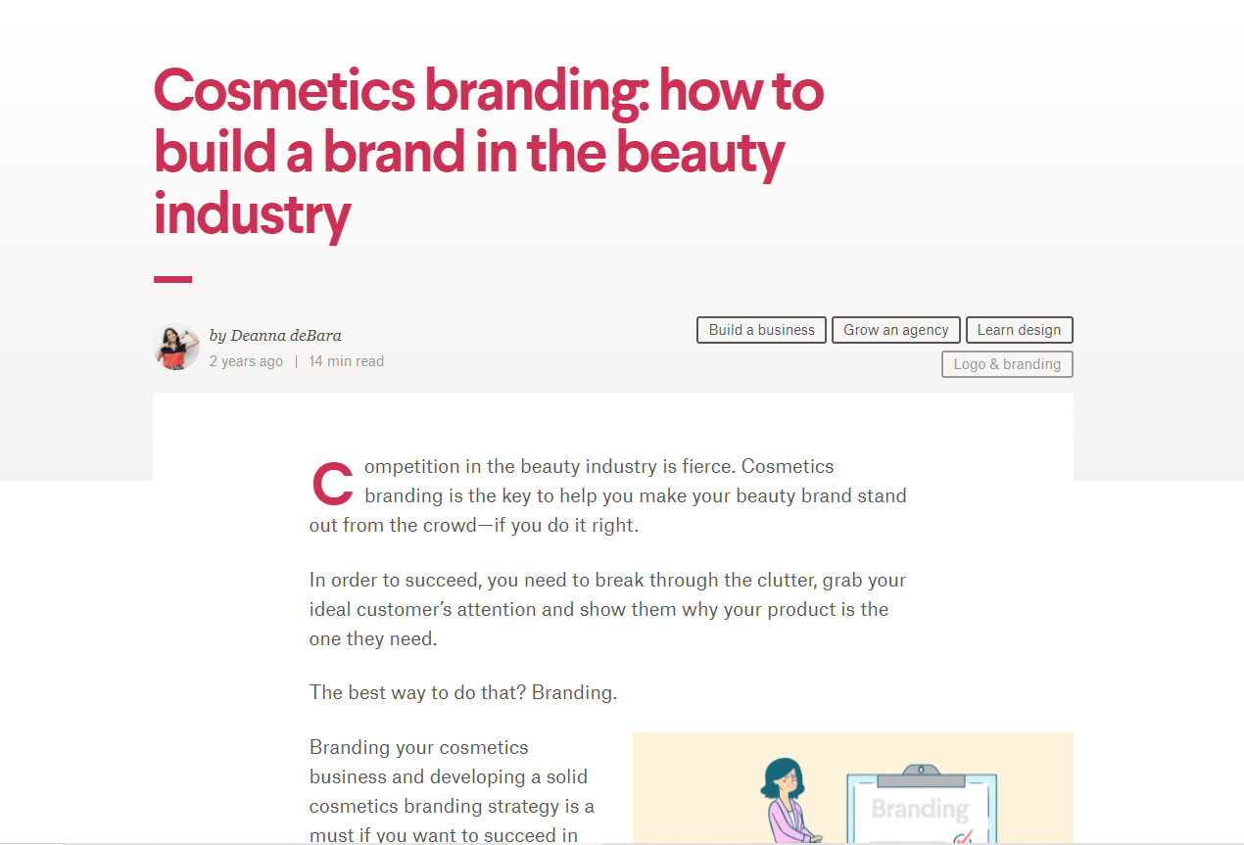
Create a ‘brand-culture’

Slide 26
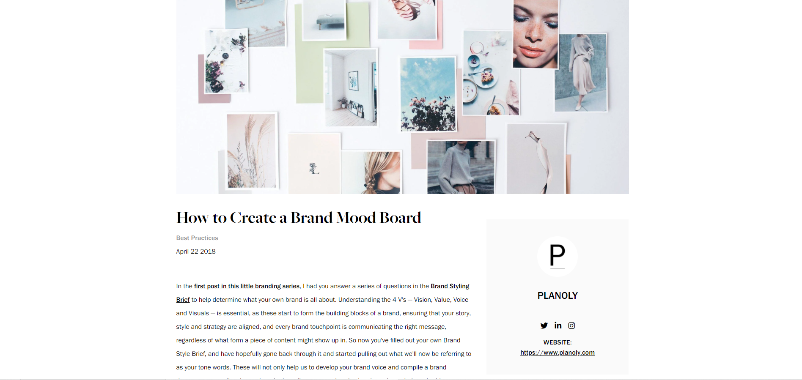
Create a mood board

Slide 27
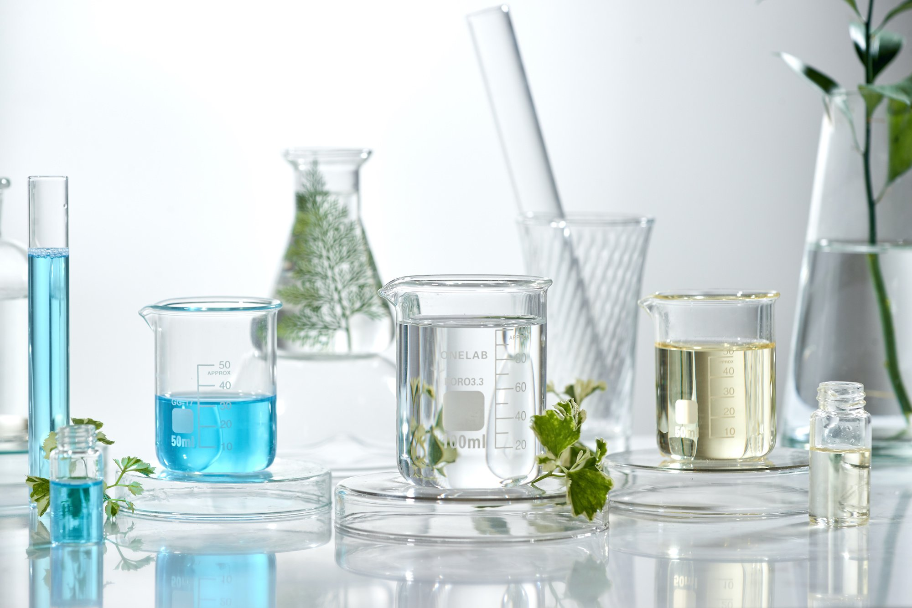
Circular Economy Cosmetics Products Innovation

Slide 28
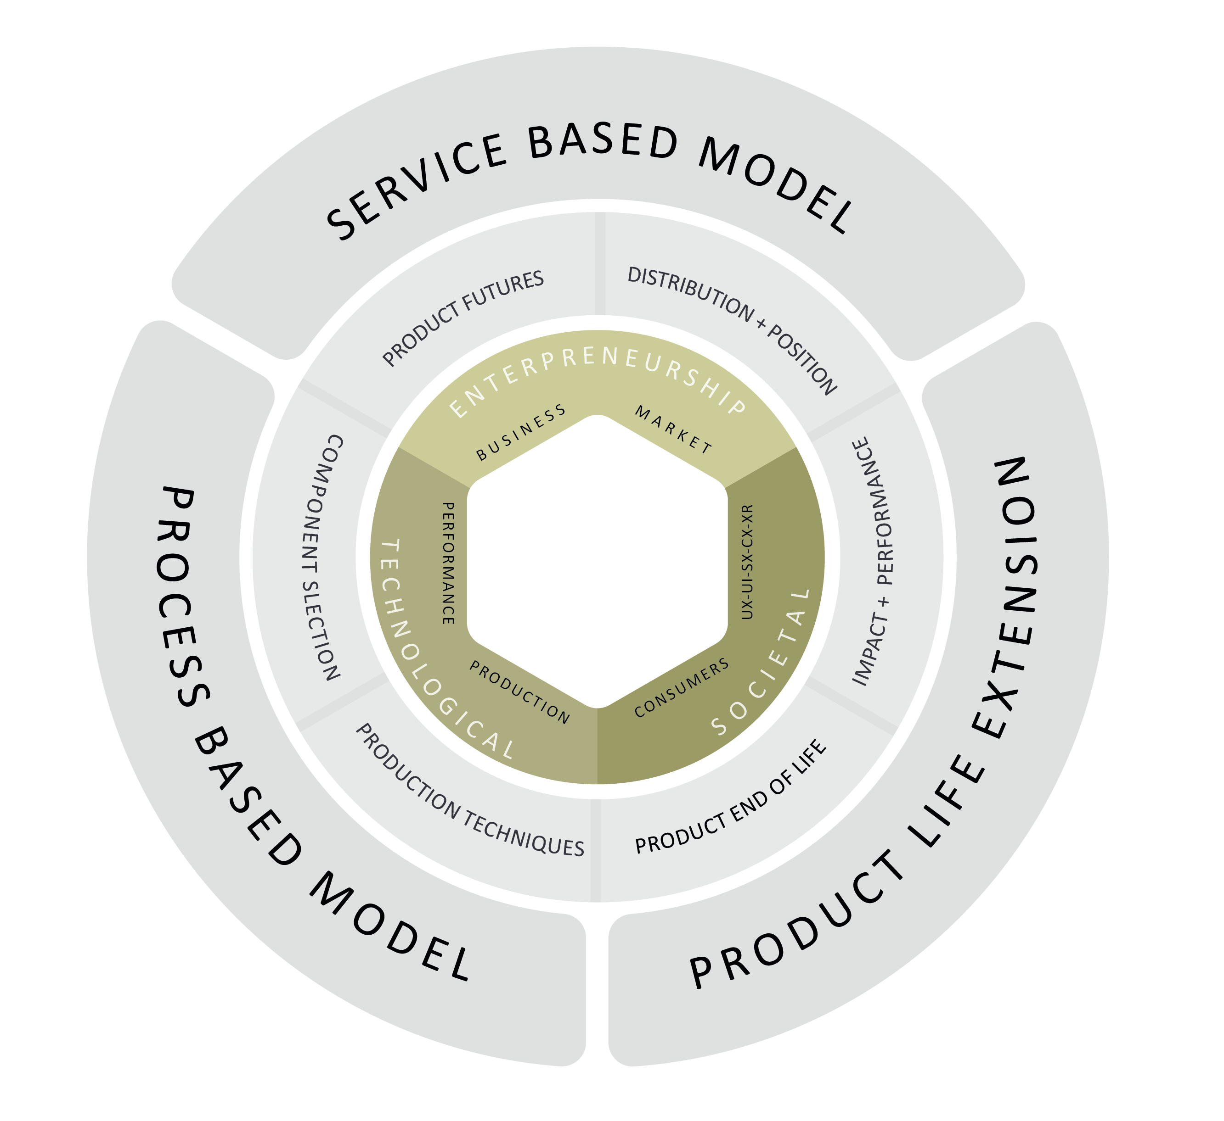
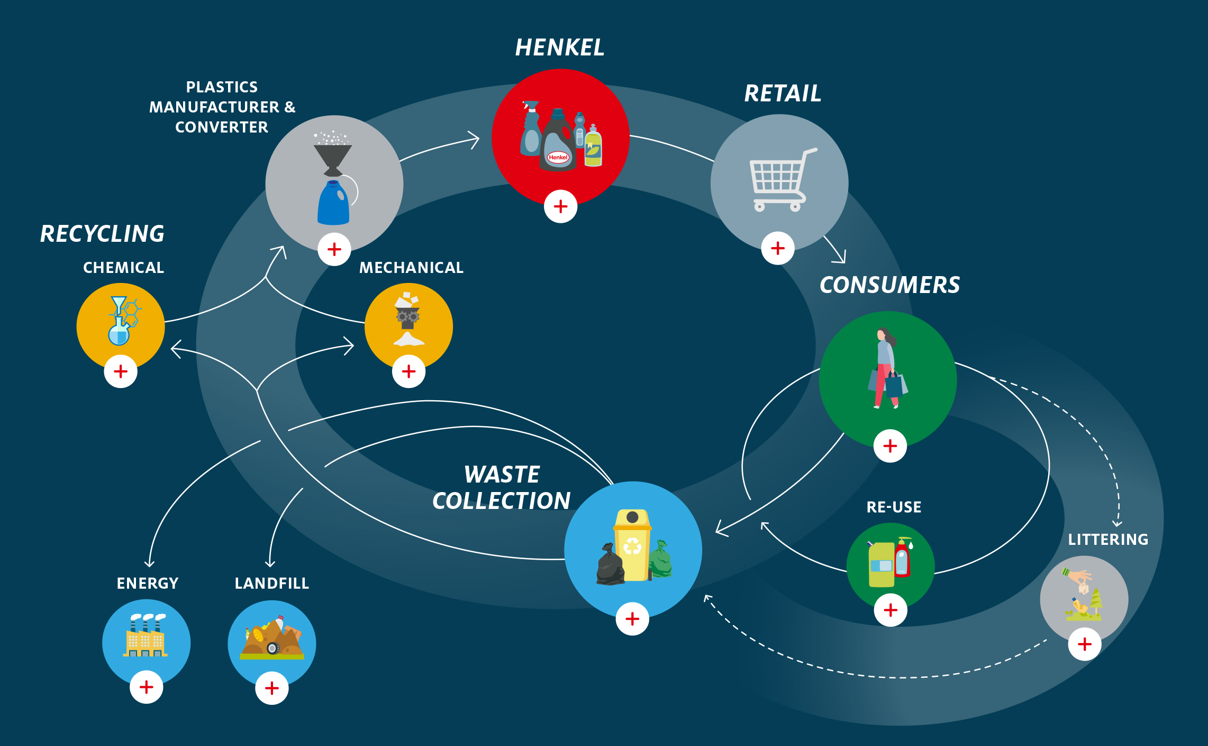

Slide 29
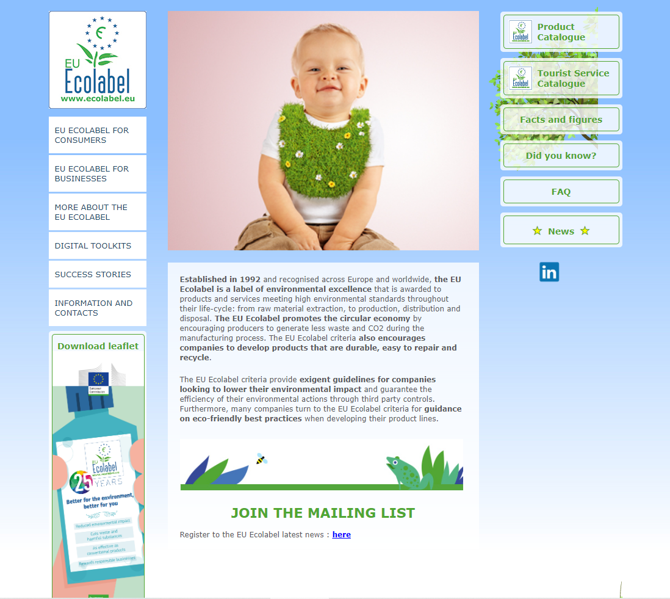
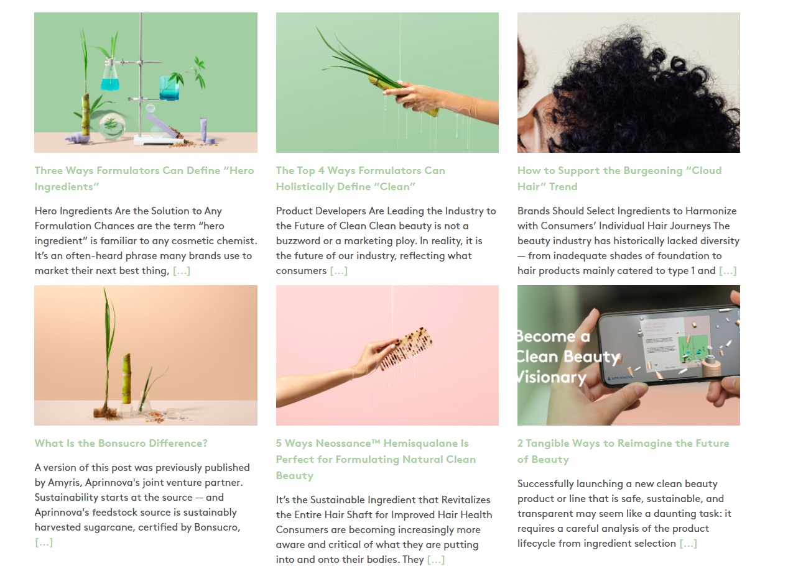

Slide 30
Sustainable Cosmetics Enterprise + Innovation ‘Thinking Toolkit’

Slide 31
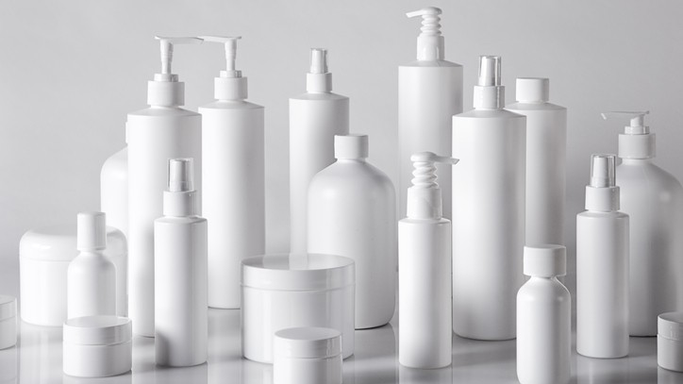

Slide 33
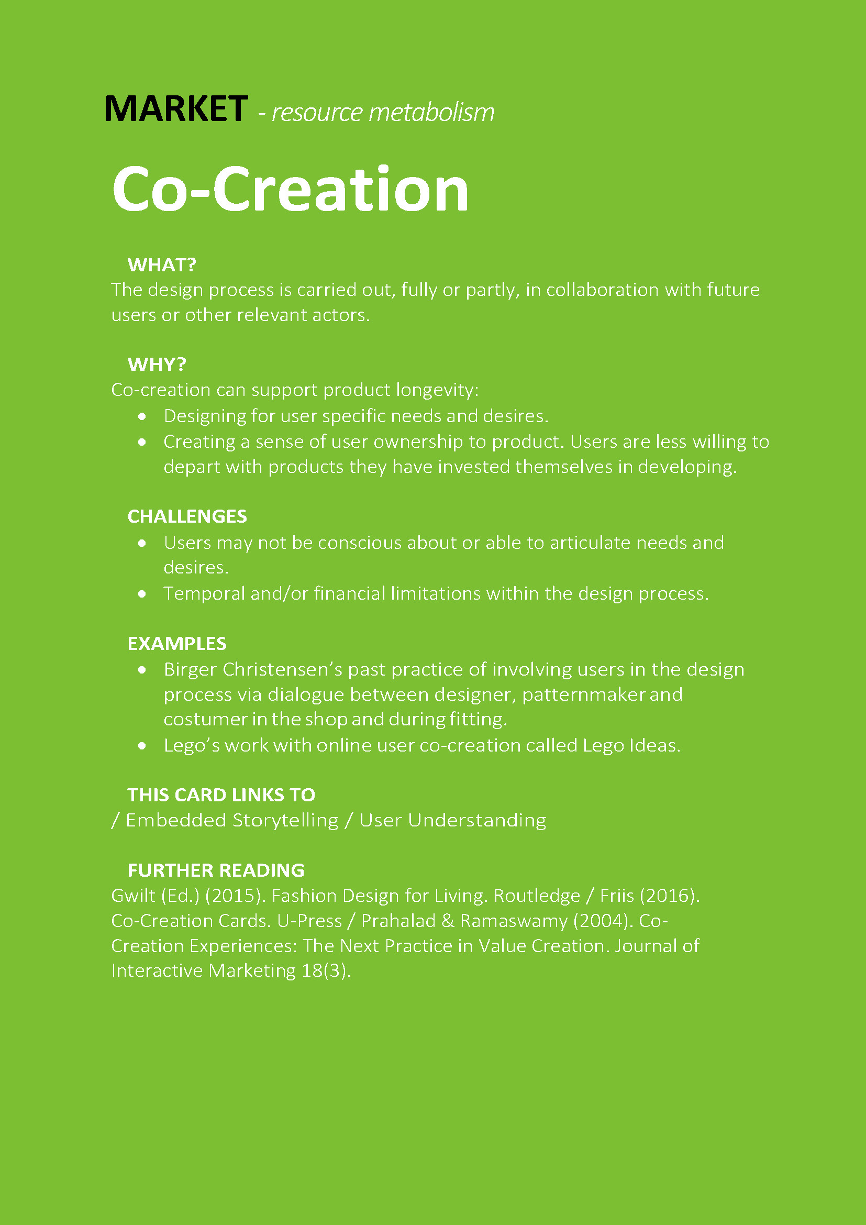

Slide 34
analysing case studies

Slide 35
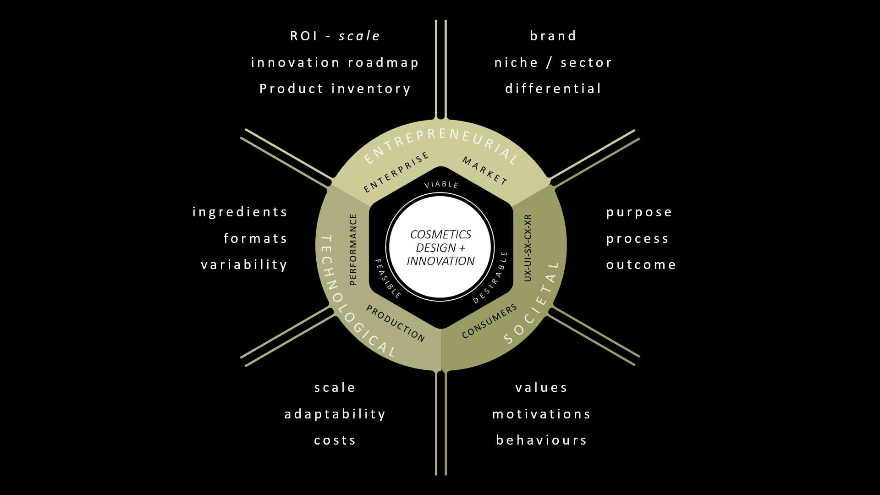
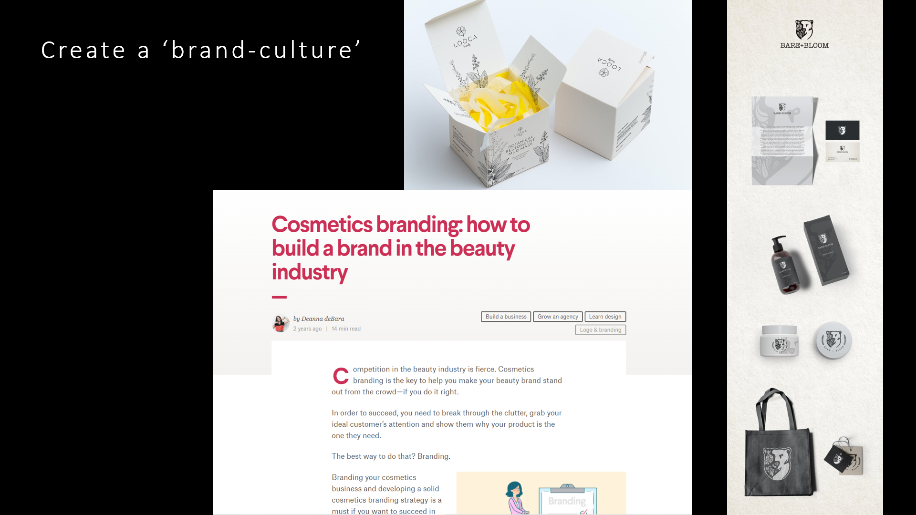
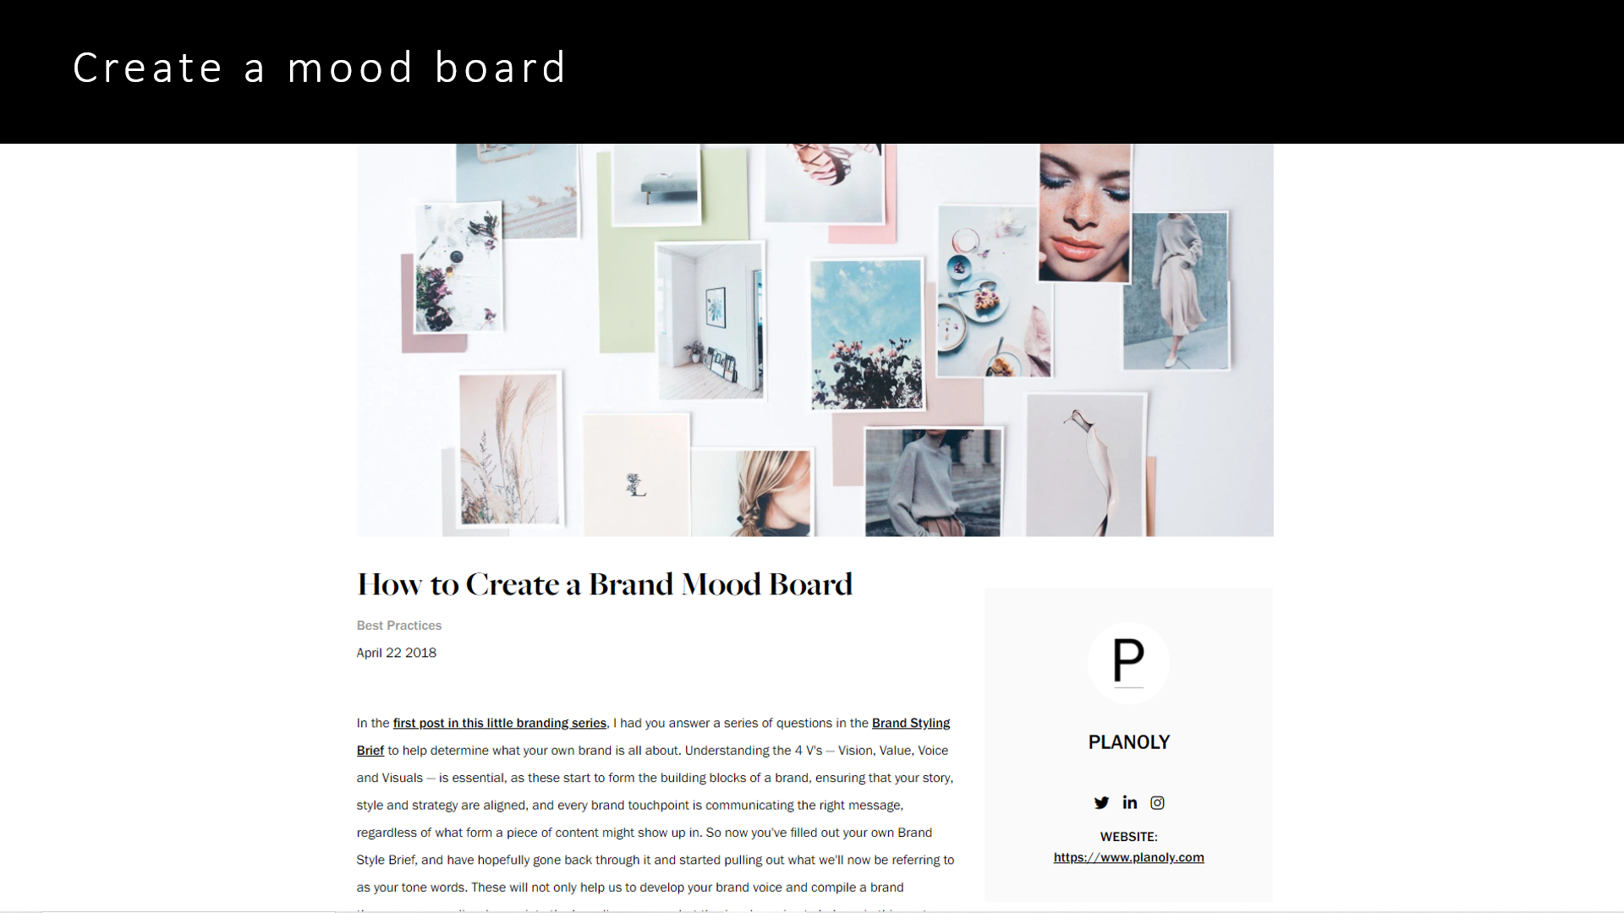
Design -Think- Storm
summary of possible follow-on actions

Slide 36
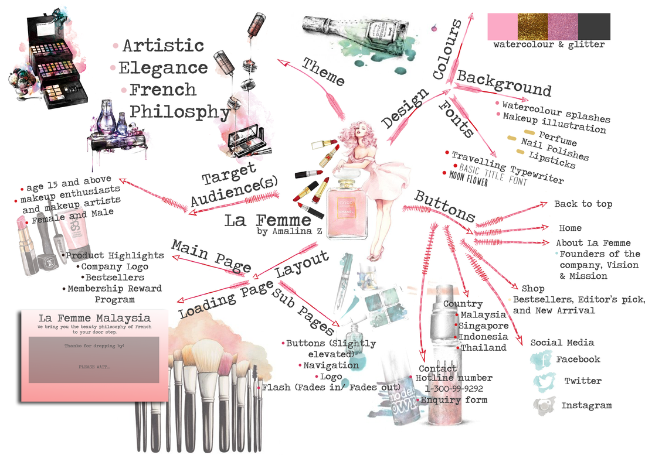
Design -Think- Storm
a ‘could do’ …probably a must-do

Slide 37
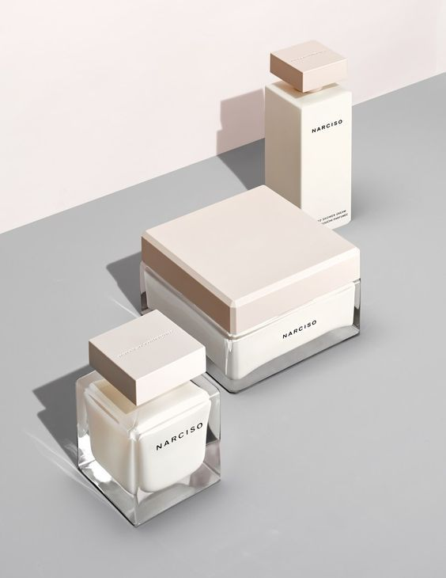
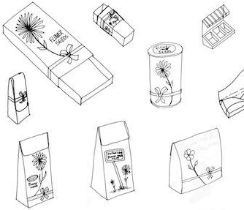

Slide 38
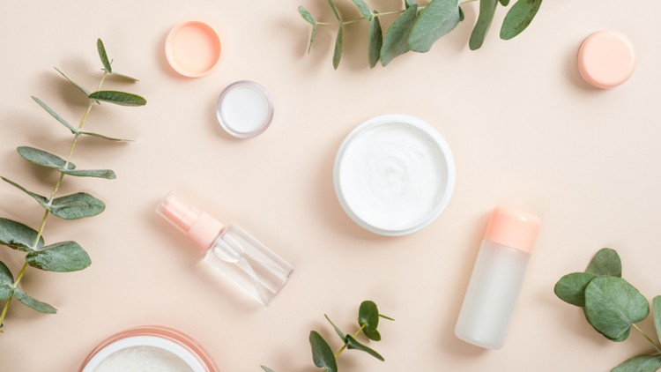
Q + A’s

